Slide 1
Precision Recall & F1
Marlabs

Slide 2
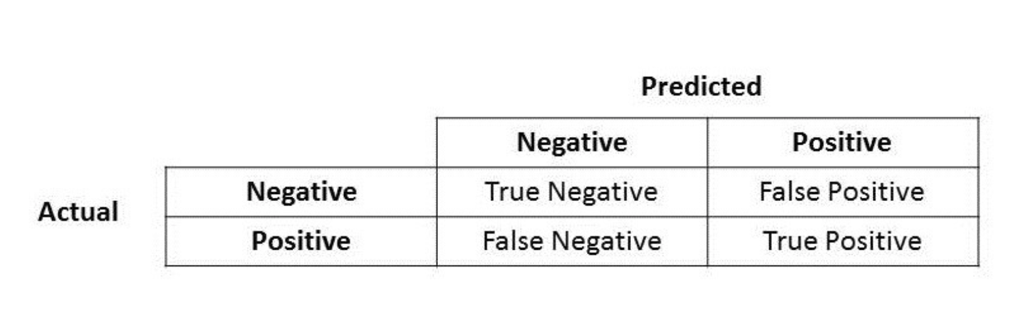
Confusion Matrix

Slide 3
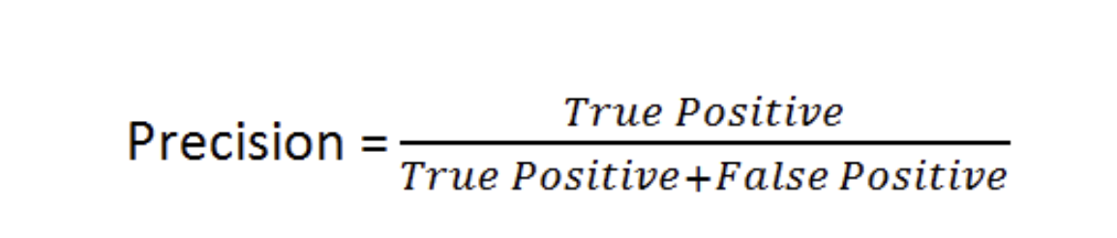
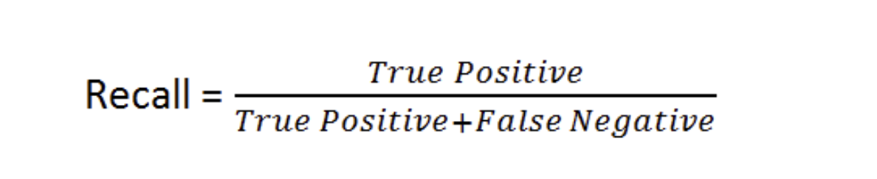
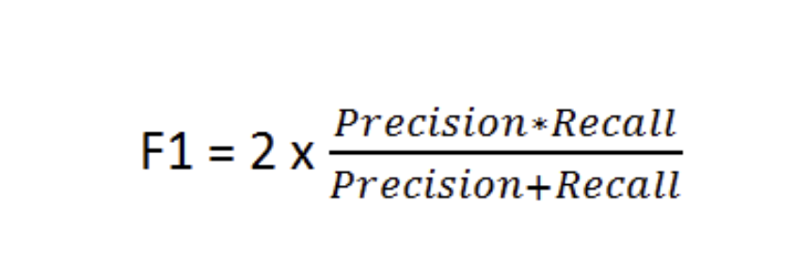

Slide 4
Precision
Precision talks about how precise/accurate your model is out of those predicted positive, how many of them are actual positive.
Precision is a good measure to determine, when the costs of False Positive is high. E.g. email spam detection, a false positive means that an email that is non-spam (actual negative) has been identified as spam (predicted spam). The email user might lose important emails if the precision is not high for the spam detection model.

Slide 5
Recall
Recall actually calculates how many of the Actual Positives our model capture through labeling it as Positive (True Positive).
For instance, in fraud detection or sick patient detection. If a fraudulent transaction (Actual Positive) is predicted as non-fraudulent (Predicted Negative), the consequence can be very bad for the bank.
Cases you would prefer False Positives to False Negatives.

Slide 6
F1 Score
F1 is a function of Precision and Recall.
F1 Score might be a better measure to use if we need to seek a balance between Precision and Recall AND there is an uneven class distribution (large number of Actual Negatives).

Slide 7
Imbalanced Dataset

